Slide 1
Interrupt Control Instructions
STI – set interrupt flag
  enables external interrupts
  always executed at beginning of an interrupt handler
CLI – clear interrupt flag
  disables external interrupts
  used before critical code sections that cannot be interrupted
  suspends the system timer

Slide 2
Keyboard Input with INT 16h
How the Keyboard Works
INT 16h Functions

Slide 3
How the Keyboard Works
Keystroke sends a scan code to the keyboard serial input port
Interrupt triggered: INT 9h service routine executes
Scan code and ASCII code inserted into keyboard type ahead buffer

Slide 4
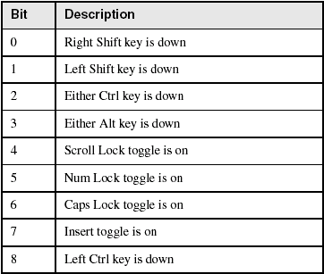
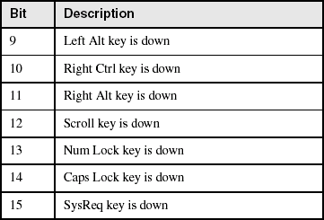
Keyboard Flags
16-bits, located at 0040:0017h – 0018h.

Slide 5
INT 16h Functions
Provide low-level access to the keyboard, more so than MS-DOS.
Input-output cannot be redirected at the command prompt.
Function number is always in the AH register
Important functions:
  set typematic (Repeat Delay and Repeat Rate) rate
  push key into buffer
  wait for key
  check keyboard buffer
  get keyboard flags

Slide 6
Function 10h: Wait for Key
If a key is waiting in the buffer, the function returns it immediately. If no key is waiting, the program pauses (blocks), waiting for user input.
.data
scanCode BYTE ?
ASCIICode BYTE ?
.code
mov ah,10h
int 16h
mov scanCode,ah
mov ASCIICode,al

Slide 7
Function 12h: Get Keyboard Flags
Retrieves a copy of the keyboard status flags from the BIOS data area.
.data
keyFlags WORD ?
.code
mov ah,12h
int 16h
mov keyFlags,ax

Slide 8
Clearing the Keyboard Buffer
Function 11h clears the Zero flag if a key is waiting in the keyboard typeahead buffer.
L1: mov ah,11h ; check keyboard buffer
int 16h ; any key pressed?
jz noKey ; no: exit now
mov ah,10h ; yes: remove from buffer
int 16h
cmp ah,scanCode ; was it the exit key?
je quit ; yes: exit now (ZF=1)
jmp L1 ; no: check buffer again
noKey: ; no key pressed
or al,1 ; clear zero flag
quit:

